Slide 1
ER-Diagrams

Slide 2
Steps to design the Software using database
Requirement Analysis: This the first step in which database designer interview the database users and prepare the data requirement. Further these requirement can be taken as functional requirement .These consist of user operations that will be applied to database for retrieval and updates.
Conceptual Designing : Once the requirement are collected then they are analyzed and conceptual schema is created .This step is known to be as conceptual designing.
The next step in database design is the actual implementation of the database, using a commercial DBMS. This step is called logical design.
The last step is the physical design phase, during which the internal storage structures, indexes, access paths, and file organizations for the database files are specified. In parallel with these activities, application programs are designed.

Slide 3
Conceptual Designing :
It includes detailed descriptions of the entity types , relationships, and constraints;
Because these concepts do not include implementation details , they are usually easier to understand and can be used to communicate with nontechnical users.
The high-level conceptual schema can also be used as a reference to ensure that all users' data requirements are met and that the requirements do not conflict.
This approach enables the database designers to concentrate on specifying the properties of the data, without being concerned with storage details.

Slide 4
E R Diagrams
The E-R Model: This can be viewed as set of Entities having attributes and Relationships among entities.
Symbols used in E-R Diagram:
Entity – rectangle
Attribute – oval
Relationship – diamond
Link - line

Slide 5
The conceptual designing is done through ER diagrams i.e. entity relationship diagrams.
Components of ER diagrams:
Entity: An entity is a thing or an object in the real world. For example :person is an entity ,book is an entity etc.
Attributes: An entity comprises of additional information which describes the entity . An entity is represented by set of attributes which are descriptive properties.

Slide 6
Attributes can be of various types:
Simple and Composite Attributes: Attributes which cannot be divided into subparts or attribute compose of single component is called simple attribute for eg: Dob is simple attribute . An attribute which can be subdivided or an attribute composed of multiple components is called composite attribute for eg : name can be further divided into subparts : first name ,middle name and last name.
Single valued and Multi Values Attributes: the entity that hold single value for a single attribute for eg : loan number is single values attribute. The attribute having more then one value for a particular entity then is is said to be multi valued attribute for eg: employee can have zero,one or more dependent.
Null Attributes :A null value attribute is that where entity does not have a value for that attribute. Suppose a employee does not have dependent then dependent will contain null in that case.

Slide 7
Notations
Derived Attribute: the value of these attribute is derived from other attributes . suppose we have to find the how many days employee has worked we can find it using current date from hiring date of employee.
Every entity have an key attribute.
Those entity who do not have key attribute are known as weak entity.
Attributes are represented by oval on E-R diagram.
May be multi-valued – use double oval
May be composite – attribute has further structure; also use oval for composite attribute, with ovals for components connected to it by lines
May be derived – a virtual attribute, one that is computable from existing data in the database, use dashed oval.

Slide 8
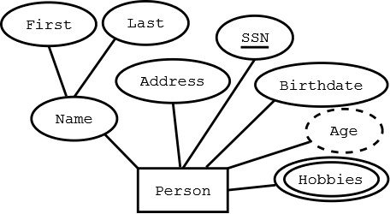

Slide 9
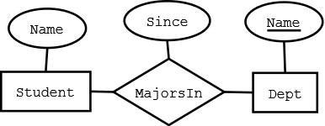
Relationships: one entity is related to other entity by specifying a relationship. For eg: A book is published by an author . Published by is the relationship here.
Degree of Relationship: The number of entities participating in the relationship is known to be as degree of relationship.
Relationship: connects two or more entities into anassociation/relationship.
Eg: "John" majors in "Computer Science“
Relationship Type: set of similar relationships
Example:
Student (entity type) is related to Department (entity type) by MajorsIn (relationship type).

Slide 10
Relationship Types may also have attributes in the E-R model.
When they are mapped to the relational model, the attributes become part of the relation.
Relationships are represented by a diamond on E-R diagram.
Relationship types can have descriptive attributes like entity sets.
Relationships tend to be verbs or verb phrases; attributes of relationships are nouns.

Slide 11
CARDINALITY
Cardinality: This specify how many entities are associated with other entities.
Cardinality can be:
One to one: one value in entity A is associated with only one value in entity B.For eg: one manager manages only one department.
ii. One to many: one value in entity A is associated with many values in B.
For eg: A department can have many number of employees.

Slide 12
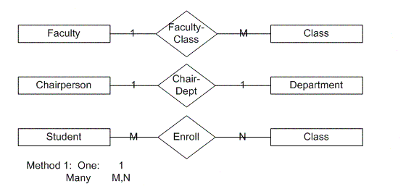
Many to one: number of entity in A is associated will only one entity in B. for eg: number of students can opt only one course.
Many to Many: Number of entities in A are associated with number of entities in B.
For eg: each student can join number of courses.

Slide 13
Participation
An entity can participate totally or partially .
Total Participation:
Every member of entity set must participate in the relationship.
Represented by double line from entity rectangle to relationship diamond.
Partial Participation:
Not every entity instance must participate
Represented by single line from entity rectangle to relationship diamond

Slide 14
Participation Constraints
Does every department have a manager?
  If so, this is a participation constraint: the participation of Departments in Manages is said to be total (vs. partial).
    Every Department MUST have at least an employee
    Every employee MUST work at least in one department
    There may exist employees managing no department
since
since
name
name
dname
dname
ssn
did
did
budget
lot
budget
Employees
Manages
Departments
Works_In
since
Notes:
8

Slide 15
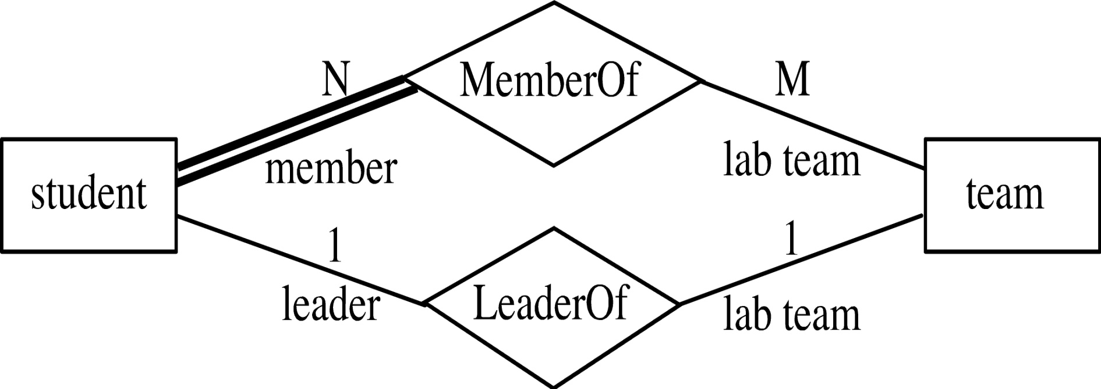
Example:Every student must be a member of a team.
Thus, we can include a participation constraint in which participation the of student in MemberOf relationship is total.

Slide 16
Weak Entity
An entity set that does not have a primary key is referred to as a weak entity set .It is represented using double rectangular box.
It must relate to the identifying entity set via a total, one-to-many relationship set from the identifying to the weak entity set.
Identifying relationship depicted using a double diamond.

Slide 17
A company insurance policy insures an employee and any dependents, the DEPENDENT cannot exist without the EMPLOYEE; that is, a person cannot get insurance coverage as a dependent unless the person is a dependent of an employee .
DEPENDENT is the weak entity in the relationship "EMPLOYEE has DEPENDENT"

Slide 18
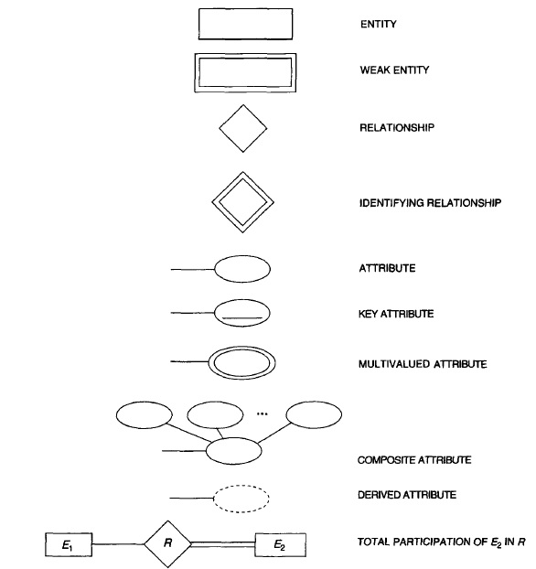

Slide 19
Question on ER diagrams
Draw an ER diagram for a hospital with a set of patients and doctors with following conditions:
Hospital is recognized by its registration number which retrieves all the other attributes and hospital also have a name . The hospital have number of doctors and number of patients.
Doctors works in hospital have specific doctor_id which is unique ,name and Specialization . A doctor treats more than one patient.
Patients are admitted in hospital have patient_id , patient name , Dob from which age can be derived and address which further subdivided into Hno , Street no and city.
Each patient is treated by doctor .A doctor may or may not treat the patient.
Doctors work in hospital for certain hours.
Patients are admitted in the hospital since when.

Slide 20
Draw An ER diagram for a car insurance company that has set of customers, each of whom owns one or more cars. Each car is associated with it zero or any number of recorded accidents.
Each customer have an customer id which is unique ,name and city.
Each car have an regno which is unique, engine no, make and model.
Each accident records have an report no through which it is recognized ,location and date.
Each and every car is owed by customer and each customer owns a car but each accident record will be stored but a car can or cannot met with an accident.
Customer owns a car since how many years.
Car reg_no is referred As record_no in accident records.

Slide 21
Draw an ER diagram for examination system based on following conditions:
A student can opt for many courses .each student have a unique roll no ,name and branch. A student can appears for number of exams . Student have to opt an course
Course may or may not be opted by a student .each course have unique course id, and course name.
Each course have a single exam and each exam have a name , place and date associated with it.
Student can opt for the courses for spring and autumn term only.

Slide 22
Draw an ER Diagram for a company that comprises of workers who belong to a department and workers works on the order and order builds product and each order is given by customer.
Each worker in the company have a unique which is divided into first name and last name and address. The address of worker can be more than one. Number of workers belong to one department. Each worker may or may not belong to a department.
Each department have dept_id which retrieve all the other attributes like name and location. Each dept have workers.
Each order have unique order_id, delivery_date, order-date. Number of workers works on an order. Each worker May or may not work on an order. Each order have workers associated with it.

Slide 23
Each order have order amount associated with product and each have a unique product_id ,name and color.one order can have number of products.Each product should be in the order.
Each customer have unique customer_id and name .Number of customer can give number of orders. Each and every order has customer.

Slide 24
Draw an ER diagram for library which comprises of books that can be issued by the member and it is published by the author and supplied by a supplier. A book section exists only if publisher exists.
Each book have ISBN_No which retrieves all other attributes ,Title , author, Price which is divided into MRP and whole sale price.
Each publisher have publisher_id which is unique, address, name comprises of first name and last name, phone no that have more than one. Number of publisher can publish number of books. Each publisher has to publish a book but a book may or may not be publish by a publisher.
In book section have been establishment date the publisher_id is referred as section_no and each it also have section_name .one publisher only have one section.

Slide 25
Each supplier have unique supplier_id,name and address.number of supplier can supply number of books.each supplier has to supply the book but book may or may not be supplier by the supplier.
Each member have unique member_id,name and member_type.Issue is associated with issue_date,return_date.each memebr can issue more than one book.

